Slide 1
SQL
Sumber: Silberschatz, Korth and Sudarshan, Database System Concepts, 6th Ed.
Program Studi Teknik Informatika
Institut Teknologi Bandung

Slide 2
Learning Outcomes
Demonstrate retrieving information from a database using the SQL SELECT statement
Demonstrate modification (insert, delete, update) of data in the database using SQL statement
Create a relational database schema in SQL that incorporates key, entity integrity, and referential integrity constraints

Slide 3
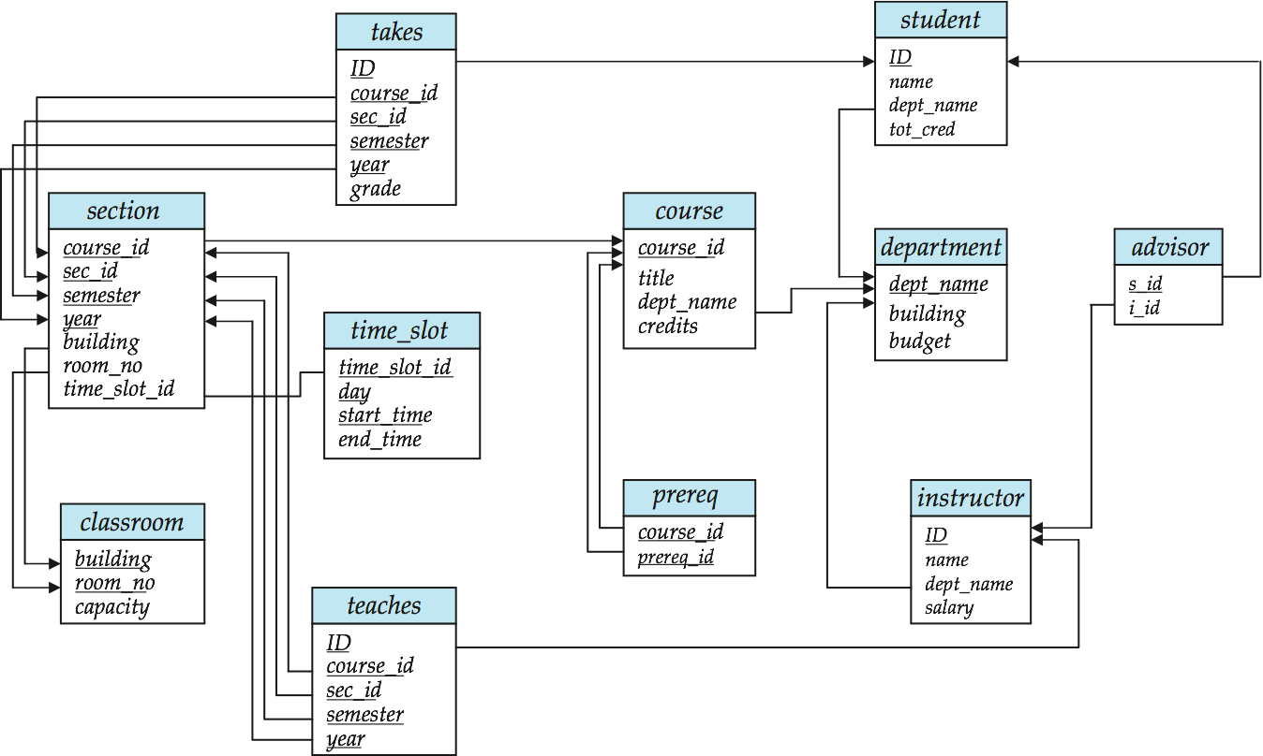
Schema Diagram for University Database

Slide 4
History
IBM Sequel language developed as part of System R project at the IBM San Jose Research Laboratory
Renamed Structured Query Language (SQL)
ANSI and ISO standard SQL:
SQL-86, SQL-89, SQL-92
SQL:1999, SQL:2003, SQL:2008
Commercial systems offer most, if not all, SQL-92 features, plus varying feature sets from later standards and special proprietary features.
Not all examples here may work on your particular system.

Slide 5
Data Manipulation Language (DML)

Slide 6
Basic Query Structure
The SQL data-manipulation language (DML) provides the ability to query information, and insert, delete and update tuples
A typical SQL query has the form: select A₁, A₂, ..., A_{n} from r₁, r₂, ..., r_{m} where P
A_{i} represents an attribute
R_{i} represents a relation
P is a predicate.
The result of an SQL query is a relation.
Notes:
2

Slide 7
The select Clause
The select clause list the attributes desired in the result of a query
corresponds to the projection operation of the relational algebra
Example: find the names of all instructors: select name from instructor
NOTE: SQL names are case insensitive (i.e., you may use upper- or lower-case letters.)
E.g. Name ≡ NAME ≡ name
Some people use upper case wherever we use bold font.
Notes:
3

Slide 8
The select Clause (Cont.)
SQL allows duplicates in relations as well as in query results.
To force the elimination of duplicates, insert the keyword distinct after select.
Find the names of all departments with instructor, and remove duplicates
select distinct dept_name from instructor
The keyword all specifies that duplicates not be removed. select all dept_name from instructor
Notes:
4

Slide 9
The select Clause (Cont.)
An asterisk in the select clause denotes “all attributes”
select * from instructor
The select clause can contain arithmetic expressions involving the operation, +, –, ∗, and /, and operating on constants or attributes of tuples.
The query:
select ID, name, salary/12 from instructor
would return a relation that is the same as the instructor relation, except that the value of the attribute salary is divided by 12.
Notes:
5

Slide 10
The where Clause
The where clause specifies conditions that the result must satisfy
Corresponds to the selection predicate of the relational algebra.
To find all instructors in Comp. Sci. dept with salary > 80000 select name from instructor where dept_name = ‘Comp. Sci.' and salary > 80000
Comparison results can be combined using the logical connectives and, or, and not.
Comparisons can be applied to results of arithmetic expressions.
Notes:
6

Slide 11
The from Clause
The from clause lists the relations involved in the query
Corresponds to the Cartesian product operation of the relational algebra.
Find the Cartesian product instructor X teaches
select ∗ from instructor, teaches
generates every possible instructor – teaches pair, with all attributes from both relations
Cartesian product not very useful directly, but useful combined with where-clause condition (selection operation in relational algebra)
Notes:
8

Slide 12
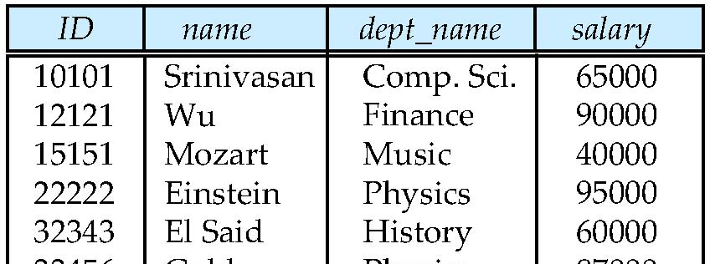
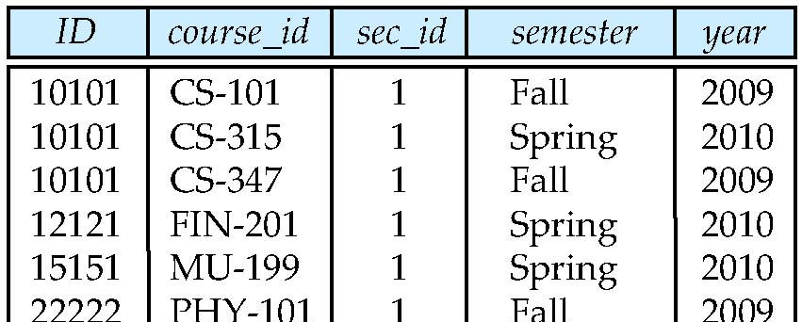
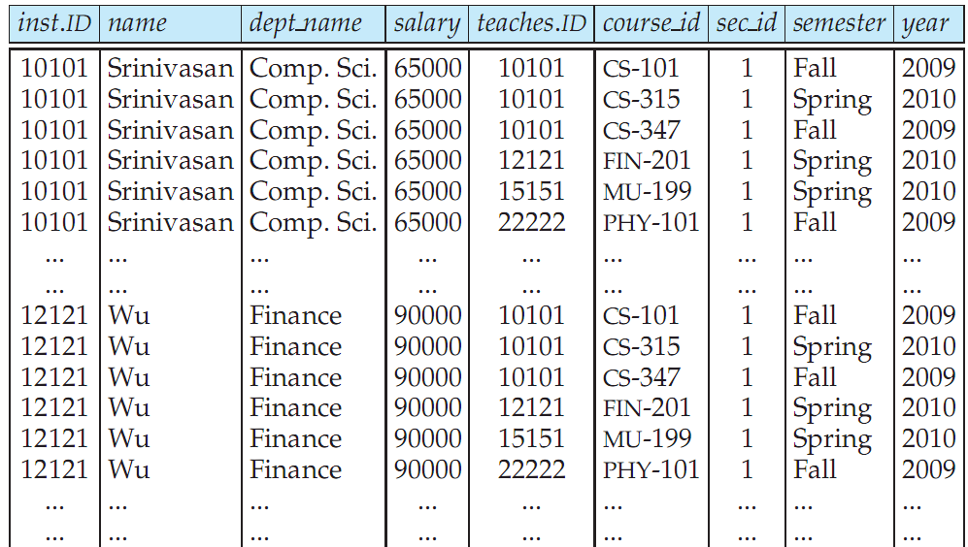
Cartesian Product: instructor X teaches
instructor
teaches

Slide 13
“Joins”
For all instructors who have taught some course, find their names and the course ID of the courses they taught.
select name, course_id from instructor, teaches where instructor.ID = teaches.ID
Find the course ID, semester, year and title of each course offered by the Comp. Sci. department
select section.course_id, semester, year, title from section, course where section.course_id = course.course_id and dept_name = ‘Comp. Sci.'
schema

Slide 14
Try Writing Some Queries in SQL
For the following queries, make sure there are no duplicates in the result.
Find the IDs and titles of courses in the Comp. Sci. department that have at least 3 credits.
Find the titles of courses that were taught at Campus Center or Octagon building in Fall 2009.
Find the IDs of all students who were taught by an instructor named Einstein.
schema
Notes:
select course_id, title from course where dept_name = ‘Comp. Sci.’ and credits >= 3;
select distinct title from course, section where course.course_id=section.course_id and semester=‘Fall’ and year=2009 and (building=‘Campus Center’ or building = ‘Octagon’);
select distinct student.ID from student, takes, teaches, instructor where student.ID=takes.ID and instructor.ID=teaches.ID and takes.course_ID=teaches.course_ID and takes.sec_ID=teaches.sec_ID and takes.semester=teaches.semester and takes.year=teaches.year and instructor.name=‘Einstein’;

Slide 15
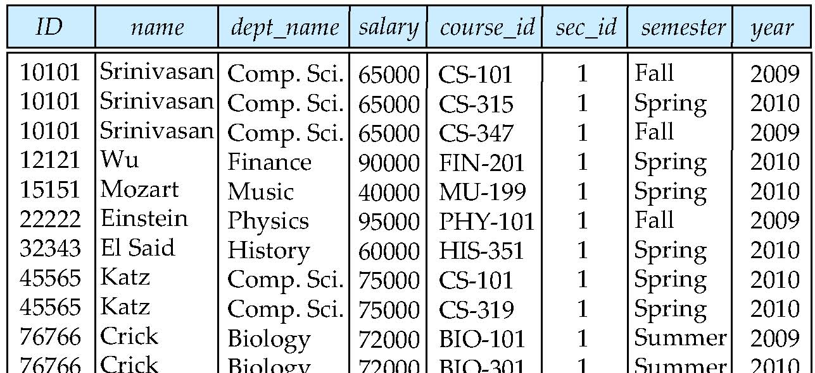
Natural Join
Natural join matches tuples with the same values for all common attributes, and retains only one copy of each common column
select * from instructor natural join teaches;

Slide 16
Natural Join Example
List the names of instructors along with the course ID of the courses that they taught.
select name, course_id from instructor, teaches where instructor.ID = teaches.ID;
select name, course_id from instructor natural join teaches;

Slide 17
Natural Join (Cont.)
Danger in natural join: beware of unrelated attributes with same name which get equated incorrectly
List the names of instructors along with the the titles of courses that they teach
Incorrect version (makes course.dept_name = instructor.dept_name)
select name, title from instructor natural join teaches natural join course;
Correct version
select name, title from instructor natural join teaches, course where teaches.course_id = course.course_id;
Another correct version
select name, title from (instructor natural join teaches) join course using(course_id);
schema

Slide 18
Try Writing Some Queries in SQL
Rewrite queries 2 and 3 on the previous exercises using join
schema
Notes:
select distinct title from course natural join section where semester=‘Fall’ and year=2009 and (building=‘Campus Center’ or building = ‘Octagon’);
select distinct student.ID from (student join takes using(ID)) join (teaches join instructor using(ID)) using(course_ID,sec_ID,semester,year) where instructor.name=‘Einstein’;

Slide 19
The Rename Operation
The SQL allows renaming relations and attributes using the as clause:
old-name as new-name
E.g.
select ID, name, salary/12 as monthly_salary from instructor
Find the names of all instructors who have a higher salary than some instructor in ‘Comp. Sci’.
select distinct T. name from instructor as T, instructor as S where T.salary > S.salary and S.dept_name = ‘Comp. Sci.’
Keyword as is optional and may be omitted instructor as T ≡ instructor T
Keyword as must be omitted in Oracle
Notes:
9

Slide 20
String Operations
SQL includes a string-matching operator for comparisons on character strings. The operator “like” uses patterns that are described using two special characters:
percent (%). The % character matches any substring.
underscore (_). The _ character matches any character.
Find the names of all instructors whose name includes the substring “dar”. select name from instructor where name like '%dar%'
Match the string “100 %”
like ‘100 \%' escape '\'

Slide 21
String Operations (Cont.)
Patters are case sensitive.
Pattern matching examples:
‘Intro%’ matches any string beginning with “Intro”.
‘%Comp%’ matches any string containing “Comp” as a substring.
‘_ _ _’ matches any string of exactly three characters.
‘_ _ _ %’ matches any string of at least three characters.
SQL supports a variety of string operations such as
concatenation (using “||”)
converting from upper to lower case (and vice versa)
finding string length, extracting substrings, etc.

Slide 22
Ordering the Display of Tuples
List in alphabetic order the names of all instructors select distinct name from instructor order by name
We may specify desc for descending order or asc for ascending order, for each attribute; ascending order is the default.
Example: order by name desc
Can sort on multiple attributes
Example: order by dept_name, name

Slide 23
Where Clause Predicates
SQL includes a between comparison operator
Example: Find the names of all instructors with salary between $90,000 and $100,000 (that is, ≥ $90,000 and ≤ $100,000)
select name from instructor where salary between 90000 and 100000
Tuple comparison
select name, course_id from instructor, teaches where (instructor.ID, dept_name) = (teaches.ID, ’Biology’);
Notes:
7

Slide 24
Duplicates
In relations with duplicates, SQL can define how many copies of tuples appear in the result.
Multiset versions of some of the relational algebra operators – given multiset relations r₁ and r₂:
1. σ_{θ} (r₁): If there are c₁ copies of tuple t₁ in r₁, and t₁ satisfies selections σ_{θ,}, then there are c₁ copies of t₁ in σ_{θ} (r₁).
2. Π_{A} (r ): For each copy of tuple t₁ in r₁, there is a copy of tuple Π_{A} (t₁) in Π_{A} (r₁) where Π_{A} (t₁) denotes the projection of the single tuple t₁.
3. r₁ x r₂ : If there are c₁ copies of tuple t₁ in r₁ and c₂ copies of tuple t₂ in r₂, there are c₁ x c₂ copies of the tuple t₁. t₂ in r₁ x r₂

Slide 25
Duplicates (Cont.)
Example: Suppose multiset relations r₁ (A, B) and r₂ (C) are as follows:
r₁ = {(1, a) (2,a)} r₂ = {(2), (3), (3)}
Then Π_{B}(r₁) would be {(a), (a)}, while Π_{B}(r₁) x r₂ would be
{(a,2), (a,2), (a,3), (a,3), (a,3), (a,3)}
SQL duplicate semantics:
select A₁,, A₂, ..., A_{n} from r₁, r₂, ..., r_{m} where P
is equivalent to the multiset version of the expression:

Slide 26
Set Operations
Find courses that ran in Fall 2009 or in Spring 2010
(select course_id from section where sem = ‘Fall’ and year = 2009) union (select course_id from section where sem = ‘Spring’ and year = 2010)
Find courses that ran in Fall 2009 and in Spring 2010
(select course_id from section where sem = ‘Fall’ and year = 2009) intersect (select course_id from section where sem = ‘Spring’ and year = 2010)
Find courses that ran in Fall 2009 but not in Spring 2010
(select course_id from section where sem = ‘Fall’ and year = 2009) except (select course_id from section where sem = ‘Spring’ and year = 2010)

Slide 27
Set Operations
Set operations union, intersect, and except
Each of the above operations automatically eliminates duplicates
To retain all duplicates use the corresponding multiset versions union all, intersect all and except all. Suppose a tuple occurs m times in r and n times in s, then, it occurs:
m + n times in r union all s
min(m,n) times in r intersect all s
max(0, m – n) times in r except all s

Slide 28
Null Values
It is possible for tuples to have a null value, denoted by null, for some of their attributes
null signifies an unknown value or that a value does not exist.
The result of any arithmetic expression involving null is null
Example: 5 + null returns null
The predicate is null can be used to check for null values.
Example: Find all instructors whose salary is null.
select name from instructor where salary is null

Slide 29
Null Values and Three Valued Logic
Any comparison with null returns unknown
Example: 5 < null or null <> null or null = null
Three-valued logic using the truth value unknown:
OR: (unknown or true) = true, (unknown or false) = unknown (unknown or unknown) = unknown
AND: (true and unknown) = unknown, (false and unknown) = false, (unknown and unknown) = unknown
NOT: (not unknown) = unknown
“P is unknown” evaluates to true if predicate P evaluates to unknown
Result of where clause predicate is treated as false if it evaluates to unknown

Slide 30
Try Writing Some More Queries
For the following queries, make sure there are no duplicates in the result.
Find the names of all instructors who have never taught any courses at Campus Center building.
Find the names of all instructors with their new salaries (named new_salary). New salary will be 1.5% higher than the old one for instructors of Comp. Sci. department, and 1.25% for all other instructors ☺.
schema
Notes:
(select name from instructor) except (select name from instructor natural join teaches natural join takes where building=‘Campus Center’);
(select name, salary*1.015 as new_salary from instructor where dept_name=‘Comp. Sci.’) union (select name, salary*1.0125 as new_salary from instructor where dept_name<>‘Comp. Sci.’);

Slide 31
Aggregate Functions
These functions operate on the multiset of values of a column of a relation, and return a value
avg: average value min: minimum value max: maximum value sum: sum of values count: number of values

Slide 32
Aggregate Functions (Cont.)
Find the average salary of instructors in the Computer Science department
select avg (salary) from instructor where dept_name= ’Comp. Sci.’;
Find the total number of instructors who teach a course in the Spring 2010 semester
select count (distinct ID) from teaches where semester = ’Spring’ and year = 2010
Find the number of tuples in the course relation
select count (*) from course;

Slide 33
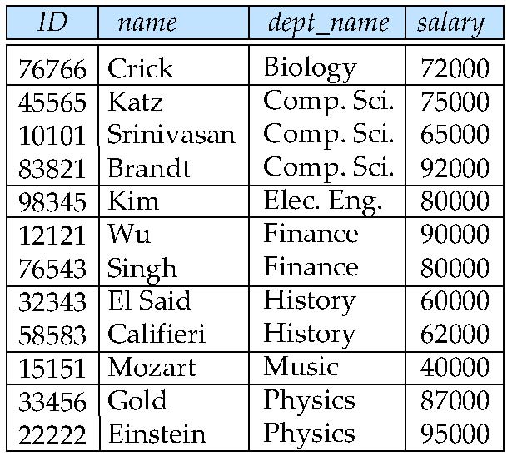
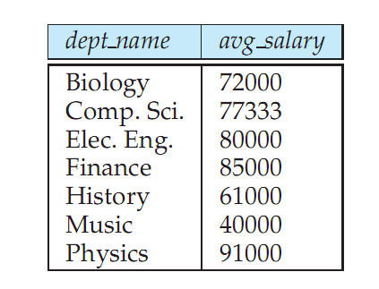
Aggregate Functions – Group By
Find the average salary of instructors in each department
select dept_name, avg (salary) from instructor group by dept_name;
Note: departments with no instructor will not appear in result

Slide 34
Aggregation (Cont.)
Attributes in select clause outside of aggregate functions must appear in group by list
/* erroneous query */ select dept_name, ID, avg (salary) from instructor group by dept_name;

Slide 35
Aggregate Functions – Having Clause
Find the names and average salaries of all departments whose average salary is greater than 42000
select dept_name, avg (salary)
from instructor
group by dept_name
having avg (salary) > 42000;
Note: predicates in the having clause are applied after the formation of groups whereas predicates in the where clause are applied before forming groups

Slide 36
Null Values and Aggregates
Total all salaries
select sum (salary ) from instructor
Above statement ignores null amounts
Result is null if there is no non-null amount
All aggregate operations except count(*) ignore tuples with null values on the aggregated attributes
What if collection has only null values?
count returns 0
all other aggregates return null

Slide 37
How About Some More Queries?
Find all instructors earning the highest salary (there may be more than one with the same salary)
Find the enrollment of each section that was offered in Autumn 2009.
Find all departments with more than 1000 students enrollments, together with the number of students for each of them. The list should be ordered by dept_name
schema
Notes:
select ID, name from instructor where salary=(select max(salary) from instructor);
select course_id, sec_id, count(ID) from section natural join takes where semester=‘Autumn’ and year = 2009 group by course_id, sec_id;
select dept_name, count(ID) from student group by dept_name having count(ID) > 1000;

Slide 38
Joined Relations
Join operations take two relations and return as a result another relation.
A join operation is a Cartesian product which requires that tuples in the two relations match (under some condition). It also specifies the attributes that are present in the result of the join
The join operations are typically used as subquery expressions in the from clause

Slide 39
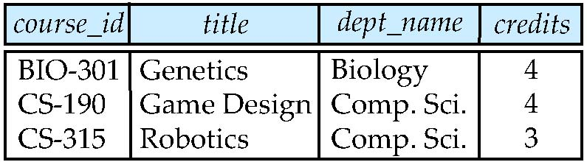
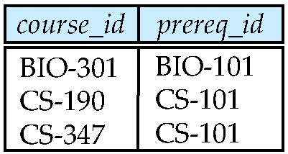
Join operations – Example
Relation course
Relation prereq
Observe that
prereq information is missing for CS-315 and
course information is missing for CS-347

Slide 40
Outer Join
An extension of the join operation that avoids loss of information.
Computes the join and then adds tuples from one relation that does not match tuples in the other relation to the result of the join.
Uses null values.

Slide 41
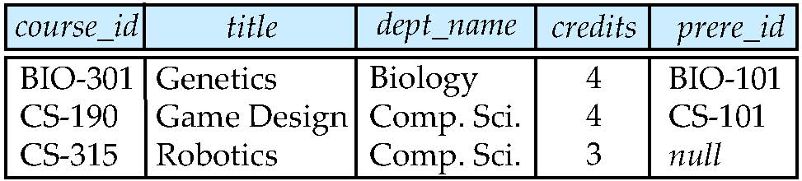
Left Outer Join
course natural left outer join prereq

Slide 42
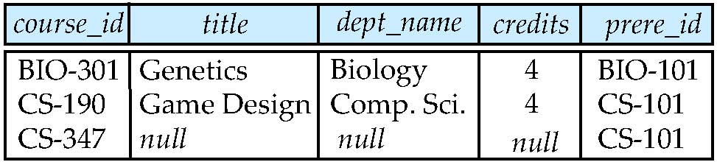
Right Outer Join
course natural right outer join prereq

Slide 43
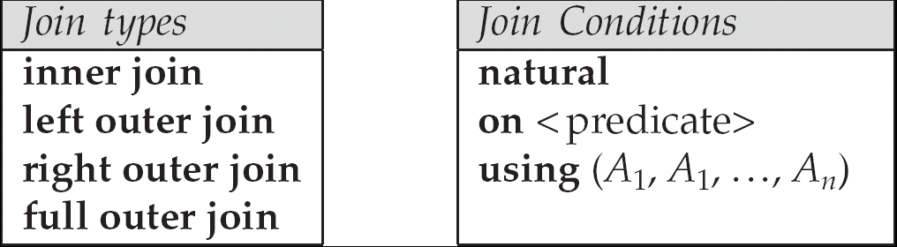
Joined Relations
Join operations take two relations and return as a result another relation.
These additional operations are typically used as subquery expressions in the from clause
Join condition – defines which tuples in the two relations match, and what attributes are present in the result of the join.
Join type – defines how tuples in each relation that do not match any tuple in the other relation (based on the join condition) are treated.

Slide 44
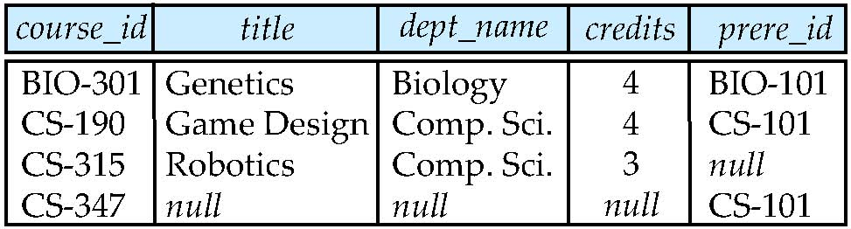
Full Outer Join
course natural full outer join prereq

Slide 45
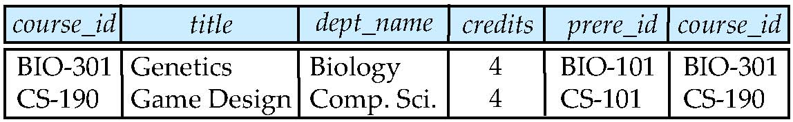
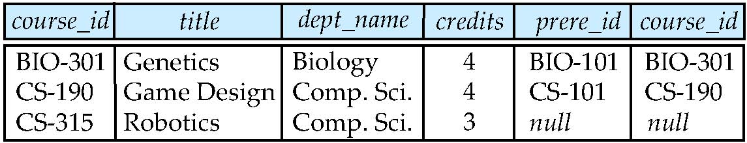
Joined Relations – Examples
course inner join prereq on course.course_id = prereq.course_id
What is the difference between the above, and a natural join?
course left outer join prereq on course.course_id = prereq.course_id

Slide 46
Joined Relations – Examples
course natural right outer join prereq
course full outer join prereq using (course_id)

Slide 47
Nested Subqueries
SQL provides a mechanism for the nesting of subqueries.
A subquery is a select-from-where expression that is nested within another query.
A common use of subqueries is to perform tests for set membership, set comparisons, and set cardinality.

Slide 48
Example Query
Find courses offered in Fall 2009 and in Spring 2010
select distinct course_id
from section
where semester = ’Fall’ and year= 2009 and course_id in (select course_id
from section
where semester = ’Spring’ and year= 2010);
Find courses offered in Fall 2009 but not in Spring 2010
select distinct course_id
from section
where semester = ’Fall’ and year= 2009 and course_id not in (select course_id
from section
where semester = ’Spring’ and year= 2010);

Slide 49
Set Comparison
Find names of instructors with salary greater than that of some (at least one) instructor in the Biology department.
select distinct T.name
from instructor as T, instructor as S
where T.salary > S.salary and S.dept_name = ’Biology’;
Same query using > some clause
select name
from instructor
where salary > some (select salary
from instructor
where dept_name = ’Biology’);

Slide 50
Definition of Some Clause
F <comp> some r ⇔ ∃ t ∈ r such that (F <comp> t ) Where <comp> can be: <, ≤, >, =, ≠
0
(5 < some
5
) = true
(read: 5 < some tuple in the relation)
6
0
(5 < some
5
) = false
0
(5 = some
) = true
5
0
(5 ≠ some
5
) = true (since 0 ≠ 5)
(= some) ≡ in
However, (≠ some) ≡ not in

Slide 51
Example Query
Find the names of all instructors whose salary is greater than the salary of all instructors in the Biology department.
select name
from instructor
where salary > all (select salary
from instructor
where dept_name = ’Biology’);

Slide 52
Definition of all Clause
F <comp> all r ⇔ ∀ t ∈ r (F <comp> t)
0
(5 < all
5
) = false
6
6
(5 < all
) = true
10
4
(5 = all
) = false
5
4
(5 ≠ all
) = true (since 5 ≠ 4 and 5 ≠ 6)
6
(≠ all) ≡ not in
However, (= all) ≡ in

Slide 53
Test for Empty Relations
The exists construct returns the value true if the argument subquery is nonempty.
exists r ⇔ r ≠ Ø
not exists r ⇔ r = Ø

Slide 54
Correlation Variables
Yet another way of specifying the query “Find all courses taught in both the Fall 2009 semester and in the Spring 2010 semester”
select course_id from section as S where semester = ’Fall’ and year= 2009 and exists (select * from section as T where semester = ’Spring’ and year= 2010 and S.course_id= T.course_id);
Correlated subquery
Correlation name or correlation variable

Slide 55
Not Exists
Find all students who have taken all courses offered in the Biology department.
select distinct S.ID, S.name
from student as S
where not exists ( (select course_id
from course
where dept_name = ’Biology’)
except
(select T.course_id
from takes as T
where S.ID = T.ID) );
Note that X – Y = Ø ⇔ X ⊆ Y
Note: Cannot write this query using = all and its variants

Slide 56
Test for Absence of Duplicate Tuples
The unique construct tests whether a subquery has any duplicate tuples in its result.
(Evaluates to “true” on an empty set)
Find all courses that were offered at most once in 2009
select T.course_id from course as T where unique (select R.course_id from section as R where T.course_id= R.course_id and R.year = 2009);

Slide 57
Subqueries in the From Clause (derived relation)
SQL allows a subquery expression to be used in the from clause
Find the average instructors’ salaries of those departments where the average salary is greater than $42,000.
select dept_name, avg_salary from (select dept_name, avg (salary) as avg_salary from instructor group by dept_name) where avg_salary > 42000;
Note that we do not need to use the having clause
Another way to write above query
select dept_name, avg_salary from (select dept_name, avg (salary) from instructor group by dept_name) as dept_avg (dept_name, avg_salary) where avg_salary > 42000;

Slide 58
With Clause
The with clause provides a way of defining a temporary view whose definition is available only to the query in which the with clause occurs.
Find all departments with the maximum budget with max_budget (value) as (select max(budget) from department) select dept_name from department, max_budget where department.budget = max_budget.value;

Slide 59
Complex Queries using With Clause
With clause is very useful for writing complex queries
Supported by most database systems, with minor syntax variations
Find all departments where the total salary is greater than the average of the total salary at all departments
with dept _total (dept_name, value) as
(select dept_name, sum(salary)
from instructor
group by dept_name),
dept_total_avg(value) as
(select avg(value)
from dept_total)
select dept_name
from dept_total, dept_total_avg
where dept_total.value >= dept_total_avg.value;

Slide 60
Scalar Subquery
Scalar subquery is one which is used where a single value is expected
E.g. select dept_name, ( select count(*) from instructor where department.dept_name = instructor.dept_name ) as num_instructors from department;
E.g. select name from instructor where salary * 10 > ( select budget from department where department.dept_name = instructor.dept_name )
Runtime error if subquery returns more than one result tuple

Slide 61
Views
In some cases, it is not desirable for all users to see the entire logical model (that is, all the actual relations stored in the database.)
Consider a person who needs to know an instructors name and department, but not the salary. This person should see a relation described, in SQL, by select ID, name, dept_name from instructor
A view provides a mechanism to hide certain data from the view of certain users.
Any relation that is not of the conceptual model but is made visible to a user as a “virtual relation” is called a view.

Slide 62
View Definition
A view is defined using the create view statement which has the form
create view v as < query expression >
where <query expression> is any legal SQL expression. The view name is represented by v.
Once a view is defined, the view name can be used to refer to the virtual relation that the view generates.
View definition is not the same as creating a new relation by evaluating the query expression
Rather, a view definition causes the saving of an expression; the expression is substituted into queries using the view.

Slide 63
Example Views
A view of instructors without their salary create view faculty as select ID, name, dept_name from instructor
Find all instructors in the Biology department select name from faculty where dept_name = ‘Biology’
Create a view of department salary totals create view departments_total_salary(dept_name, total_salary) as select dept_name, sum (salary) from instructor group by dept_name;

Slide 64
Modification of the Database
Deletion of tuples from a given relation
Insertion of new tuples into a given relation
Updating values in some tuples in a given relation

Slide 65
Modification of the Database – Deletion
Delete all instructors
delete from instructor
Delete all instructors from the Finance department delete from instructor where dept_name= ’Finance’;
Delete all tuples in the instructor relation for those instructors associated with a department located in the Watson building. delete from instructor where dept_name in (select dept_name from department where building = ’Watson’);

Slide 66
Deletion (Cont.)
Delete all instructors whose salary is less than the average salary of instructors
delete from instructor
where salary< (select avg (salary) from instructor);
Problem: as we delete tuples from deposit, the average salary changes
Solution used in SQL:
First, compute avg salary and find all tuples to delete
Next, delete all tuples found above (without recomputing avg or retesting the tuples)

Slide 67
Modification of the Database – Insertion
Add a new tuple to course
insert into course values (’CS-437’, ’Database Systems’, ’Comp. Sci.’, 4);
or equivalently insert into course (course_id, title, dept_name, credits) values (’CS-437’, ’Database Systems’, ’Comp. Sci.’, 4);
Add a new tuple to student with tot_creds set to null insert into student values (’3003’, ’Green’, ’Finance’, null);

Slide 68
Insertion (Cont.)
Add all instructors to the student relation with tot_creds set to 0
insert into student select ID, name, dept_name, 0 from instructor
The select from where statement is evaluated fully before any of its results are inserted into the relation (otherwise queries like insert into table1 select * from table1 would cause problems, if table1 did not have any primary key defined.

Slide 69
Modification of the Database – Updates
Increase salaries of instructors whose salary is over $100,000 by 3%, and all others receive a 5% raise
Write two update statements:
update instructor set salary = salary * 1.03 where salary > 100000; update instructor set salary = salary * 1.05 where salary <= 100000;
The order is important
Can be done better using the case statement (next slide)

Slide 70
Case Statement for Conditional Updates
Same query as before but with case statement
update instructor set salary = case when salary <= 100000 then salary * 1.05 else salary * 1.03 end

Slide 71
Updates with Scalar Subqueries
Recompute and update tot_creds value for all students
update student S set tot_cred = ( select sum(credits) from takes natural join course where S.ID= takes.ID and takes.grade <> ’F’ and takes.grade is not null);
Sets tot_creds to null for students who have not taken any course
Instead of sum(credits), use:
case when sum(credits) is not null then sum(credits) else 0 end

Slide 72
Data Definition Language (DDL)

Slide 73
Data Definition Language
The SQL data-definition language (DDL) allows the specification of information about relations, including:
The schema for each relation.
The domain of values associated with each attribute.
Integrity constraints
And as we will see later, also other information such as
The set of indices to be maintained for each relations.
Security and authorization information for each relation.
The physical storage structure of each relation on disk.

Slide 74
Domain Types in SQL
char(n). Fixed length character string, with user-specified length n.
varchar(n). Variable length character strings, with user-specified maximum length n.
int. Integer (a finite subset of the integers that is machine-dependent).
smallint. Small integer (a machine-dependent subset of the integer domain type).
numeric(p,d). Fixed point number, with user-specified precision of p digits, with n digits to the right of decimal point.
real, double precision. Floating point and double-precision floating point numbers, with machine-dependent precision.
float(n). Floating point number, with user-specified precision of at least n digits.
More are covered in Chapter 4.

Slide 75
Create Table Construct
An SQL relation is defined using the create table command:
create table r (A₁ D₁, A₂ D₂, ..., A_{n} D_{n}, (integrity-constraint₁), ..., (integrity-constraint_{k}))
r is the name of the relation
each A_{i} is an attribute name in the schema of relation r
D_{i} is the data type of values in the domain of attribute A_{i}
Example:
create table instructor ( ID char(5), name varchar(20) not null, dept_name varchar(20), salary numeric(8,2))
insert into instructor values (‘10211’, ’Smith’, ’Biology’, 66000);
insert into instructor values (‘10211’, null, ’Biology’, 66000);

Slide 76
Integrity Constraints in Create Table
not null
primary key (A₁, ..., A_{n} )
foreign key (A_{m}, ..., A_{n} ) references r
Example: Declare ID as the primary key for instructor
.
create table instructor ( ID char(5), name varchar(20) not null, dept_name varchar(20), salary numeric(8,2), primary key (ID), foreign key (dept_name) references department)
primary key declaration on an attribute automatically ensures not null

Slide 77
And a Few More Relation Definitions
create table student ( ID varchar(5), name varchar(20) not null, dept_name varchar(20), tot_cred numeric(3,0), primary key (ID), foreign key (dept_name) references department) );
create table takes ( ID varchar(5), course_id varchar(8), sec_id varchar(8), semester varchar(6), year numeric(4,0), grade varchar(2), primary key (ID, course_id, sec_id, semester, year), foreign key (ID) references student, foreign key (course_id, sec_id, semester, year) references section );
Note: sec_id can be dropped from primary key above, to ensure a student cannot be registered for two sections of the same course in the same semester

Slide 78
And more still
create table course ( course_id varchar(8) primary key, title varchar(50), dept_name varchar(20), credits numeric(2,0), foreign key (dept_name) references department) );
Primary key declaration can be combined with attribute declaration as shown above

Slide 79
Drop and Alter Table Constructs
drop table student
Deletes the table and its contents
delete from student
Deletes all contents of table, but retains table
alter table
alter table r add A D
where A is the name of the attribute to be added to relation r and D is the domain of A.
All tuples in the relation are assigned null as the value for the new attribute.
alter table r drop A
where A is the name of an attribute of relation r
Dropping of attributes not supported by many databases

